Slide 1
Homelessness Workshop
City Council
September 17, 2019
Item #1
CityOfGlendora.org
Notes:
Adam Raymond

Slide 2
WELCOME
Notes:
Adam Raymond

Slide 3
WELCOME
Mayor
City Manager
Notes:
Mayor
Adam Raymond

Slide 4
AGENDA
Welcome
Where are we now?
Legal Environment
Homeless Encampments
Housing
Homeless Resources
Staff Involvement
Community Involvement
Closing
Notes:
Adam Raymond

Slide 5
WHERE ARE WE NOW?
Notes:
Debbie Lopez

Slide 6
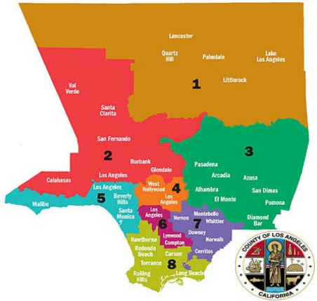
WHERE ARE WE NOW?
Homelessness Count
  Every January
    Assistance of City staff, volunteers, and LAHSA
    Spa 3
Notes:
WHERE ARE WE NOW?
Homelessness Count
Last Three Years
2019 = 65
2018 = 60
2017 = 220 - 201 in emergency shelters and 18 unsheltered
The challenge with data is that the numbers in the graph do not add up to their actual number because of the formula they use.
LAHSA is the Los Angeles Homeless Services Authority
And we are in SPA 3 = Service Planning Areas = Los Angeles County is divided into eight SPA’s for health care planning purposes. Spa 3 is the San Gabriel Valley Pasadena, Arcadia, Irwindale, Alhambra, El Monte Diamond Bar, Pomona, San Dimas, Glendora, Azusa.

Slide 7
WHERE ARE WE NOW?
Homelessness Count
  2017
    220 (202 in cold weather shelter + 18 unsheltered)
  2018
    60 unsheltered
  2019
    65 unsheltered
Notes:
Debbie Lopez

Slide 8
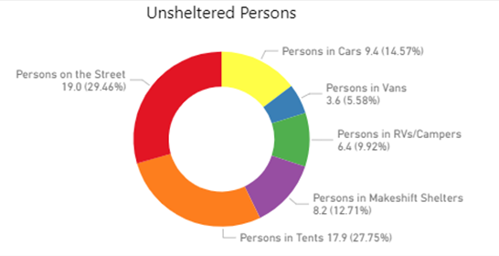
WHERE ARE WE NOW?
Homelessness Count - 2019
  Estimates based on regional statistics
  We need better data to make more informed decisions
Notes:
Debbie Lopez

Slide 9
WHERE ARE WE NOW?
Homelessness Strategic Plan
  Adopted by City Council on June 2018
  Shelter Emergency Adopted by City Council on May 17, 2018

Slide 10
WHERE ARE WE NOW?
Goal 1: Improve Community Engagement and Coordination Between Key Stakeholders, Including the Regional Coordinated Entry System
Goal 2: Increase Income of Individuals and Families Experiencing or At-Risk of Homelessness
Goal 3: Explore Opportunities to Increase Access to Affordable and Supportive Housing
Notes:
Goal 1 – We are currently working on this.
Goal 2 – Once we get the homeless liaison and the homeless Navigator they will work directly with the individuals.
Goals 3 – Not started?

Slide 11
WHERE ARE WE NOW?
Goal 1:
  Appoint a standing committee consisting of City staff and key community stakeholders to meet quarterly on homelessness, coordinate referrals, volunteers, and other services, and assist with implementation of the Homeless Plan – in progress.
  Encourage City staff members or other appointees to participate in regional CES case-conferencing meetings in order to network and support housing goals – in progress.

Slide 12
WHERE ARE WE NOW?
Goal 1:
  Coordinate local outreach efforts, including MET and HALO teams and YWCA, and ensure that these are trauma-informed, non-duplicative, and lead to pathways to housing by conducting the VI-SPDAT, and assisting with documentation and income – in progress.
  Engage with Glendora and Charter Oak Unified School Districts to identify families and youth experiencing homelessness or at-risk of homelessness and ensure they are connected to CES – not started.
Notes:
MET is the Mental Evaluation Team
HALO Homeless Assistance Liaison

Slide 13
WHERE ARE WE NOW?
Goal 1:
  Encourage City staff, homeless services providers, and general public to participate in the PIT Count – in progress and on going.
  Develop a community engagement strategy to conduct regular outreach on Homeless Plan implementation – in progress.
  Partner with regional CES lead to improve access to County prevention assistance through CES alignment and enhanced education to local service providers on program requirements – in progress.

Slide 14
WHERE ARE WE NOW?
Goal 1:
  Work with local non-profits, faith-based organizations, and SPA 3 CES lead, to provide CES access point at existing service locations (e.g. library, food pantry, churches). Consider combining with expanded services, including mobile showers, animal care, and small safe parking area – in progress.
  Work with LA County to access California State AB109 funds for Homeless Outreach Services Teams (HOST) – Completed. Funds are no longer available
Notes:
Access –Union Station Homeless submitted a grant to have Shepard’s Pantry located on Arrow Highway to become an access center in January 2019. This was not approved.

Slide 15
WHERE ARE WE NOW?
Goal 2:
  Ensure City departments and other partners are educated on County programs that provide SSI/SSDI/Veterans benefits advocacy and understand the referral process - in progress
  Explore partnering with business community, faith-based organizations, school districts and colleges to offer job training and employment opportunities to households experiencing or at risk of homelessness – in progress
Notes:
Measure H Grant Update
Priority 1 – cities and what’s included – Glendora, San Dimas & La Verne – Glendora is the lead agency. $305,000 = $120,000 for a homelessness Liaison who will oversee the motel voucher program which includes identifying motels to be part of the Pilot Motel Voucher Program. Assist in outreach, locating and placement in appropriate housing that meets the needs of the homeless in addition to administering the Rapid Re-Housing Pilot Program. $70,200 to pilot a motel voucher program to provide immediate shelter for unsheltered households. $85,500 Rapid Re-Housing pilot program will provide funds for security deposit, up to 6 months of stepped down rental assistance, and case management for up to 15 households over an 18 month period. $40,500 to manage the rapid re-housing.
Priority 2 – cities and what’s included – 1 Full time Case manager Supervisor and 4 full time Case Managers – Enhance County service systems for those experiencing or at-risk of homelessness. The Supervisor will coordinate with each city , supervise the four case managers, identify co-location sites, maintain relationships with the CES and housing providers, and develop a network of partners across cities, faith groups, and others. The Supervisor will also provide services to clients and will do all grant reporting. The staff will partner with law enforcement and other outreach efforts and will work with landlords and people experiencing homelessness to find housing options based on client needs. They will coordinate regional outreach, work as a group on outreach efforts in individual cities, and provide staffing to other special projects. This effort aligns with County Homeless Initiative Strategies E6 (Countywide Outreach System) and E7 (Strengthen the Coordinated Entry System).
List of outstanding questions
Remaining Hurdles the City needs to jump through

Slide 16
WHERE ARE WE NOW?
Goal 3:
  Explore funding sources for Rapid Re-housing program for individuals experiencing homelessness in Glendora and partnering with LA County to provide rent differential and case management services – on-going.
  Work with the faith-based community to engage landlords, build a pool of potential rental units, and explore options for incentivizing landlords to work with homeless families and individuals – consider partnering with neighboring cities to develop this – in progress.
Notes:
Rapid Rehousing funds are included in one of our approved grants.

Slide 17
WHERE ARE WE NOW?
Goal 3:
  Explore ways to incentivize renting Accessory Dwelling Units to low-income households or homeless individuals - not started
  Explore potential for creating permanent supportive housing or crisis housing at underutilized properties, in conjunction with County, Ministerial Association, and other regional partners – in progress

Slide 18
WHERE ARE WE NOW?
Homelessness Strategic Plan
  Total Plan: $4.1 million over 18-months
    Additional staff, overtime, contractual services

Slide 19
WHERE ARE WE NOW?
Measure H Grant Update
  Homelessness Action Plan - $30,000
  Award $305,000
    Cities of Glendora, San Dimas and La Verne
  Cities of Award - $343,250
    Cities of West Covina, Covina, Azusa, Duarte and Glendora

Slide 20
WHERE ARE WE NOW?
Awarded on May 31, 2019 - $305,000 – 18 months
  $120,000 for Homelessness Liaison
  $70,200 for pilot motel voucher program
  $85,500 for Rapid Re-Housing pilot program
  $40,500 to manage the Rapid Re-Housing
Notes:
Measure H Grant Update
Priority 1 – cities and what’s included – Glendora, San Dimas & La Verne – Glendora is the lead agency. $305,000 =
$120,000 for a homelessness Liaison who will oversee the motel voucher program which includes identifying motels to be part of the Pilot Motel Voucher Program. Assist in outreach, locating and placement in appropriate housing that meets the needs of the homeless in addition to administering the Rapid Re-Housing Pilot Program.
$70,200 to pilot a motel voucher program to provide immediate shelter for unsheltered households.
$85,500 Rapid Re-Housing pilot program will provide funds for security deposit, up to 6 months of stepped down rental assistance, and case management for up to 15 households over an 18 month period.
$40,500 to manage the rapid re-housing.
Priority 2 – cities and what’s included – 1 Full time Case manager Supervisor and 4 full time Case Managers – Enhance County service systems for those experiencing or at-risk of homelessness. The Supervisor will coordinate with each city , supervise the four case managers, identify co-location sites, maintain relationships with the CES and housing providers, and develop a network of partners across cities, faith groups, and others. The Supervisor will also provide services to clients and will do all grant reporting. The staff will partner with law enforcement and other outreach efforts and will work with landlords and people experiencing homelessness to find housing options based on client needs. They will coordinate regional outreach, work as a group on outreach efforts in individual cities, and provide staffing to other special projects. This effort aligns with County Homeless Initiative Strategies E6 (Countywide Outreach System) and E7 (Strengthen the Coordinated Entry System).
List of outstanding questions
Remaining Hurdles the City needs to jump through

Slide 21
WHERE ARE WE NOW?
Awarded on January 24, 2019 - $343,250 – 18 months
  1 full time Case Manager Supervisor
  4 full time Case Managers
  Total Project Budget is $643,530
  Total cash match per city is $33,000
Notes:
Priority 2 –Enhance County service systems for those experiencing or at-risk of homelessness. The Supervisor will coordinate with each city , supervise the four case managers, identify co-location sites, maintain relationships with the CES and housing providers, and develop a network of partners across cities, faith groups, and others. The Supervisor will also provide services to clients and will do all grant reporting. The staff will partner with law enforcement and other outreach efforts and will work with landlords and people experiencing homelessness to find housing options based on client needs. They will coordinate regional outreach, work as a group on outreach efforts in individual cities, and provide staffing to other special projects. This effort aligns with County Homeless Initiative Strategies E6 (Countywide Outreach System) and E7 (Strengthen the Coordinated Entry System).

Slide 22
WHERE ARE WE NOW?
Regional Funding
  California State Senator Susan Rubio - $5.625 million for SGV in State’s Budget
  County BOS - $6 million for COGs
    September 2019 Motion (Kathryn Barger and Hilda Solis)
    Innovative solutions
  San Gabriel Valley Regional Housing Trust (JPA)
    SGVCOG Project
    SB 751 (Rubio)
Notes:
Debbie Lopez

Slide 23
LEGAL ENVIRONMENT
Notes:
Adam Raymond

Slide 24
LEGAL ENVIRONMENT
City Attorney’s Office
District Attorney’s Office
Notes:
Adam Raymond

Slide 25
LEGAL ENVIRONMENT
City Attorney
  Martin v. City of Boise
  Orange County Catholic Worker v. Orange County
  Carl Mitchell v. City of Los Angeles
  Human Right Orange County, et al. v. County of Orange [San Clemente]
Notes:
Lona Laymon

Slide 26

The District Attorney’s Office and the
Criminal Justice System
By Deanne Castorena,
DIC West Covina
Notes:
Deanne Castorena

Slide 27
DE-INCARCERATION
36
109
47
57
64
10
1810
Notes:
Deanne Castorena

Slide 28
PROP 36
2000
Substance Abuse and Crime Prevention Act
Addiction is a disease
Probation with treatment
Multiple failures allowed before incarceration
Notes:
Deanne Castorena

Slide 29
AB 109
2011
Public Safety Realignment Program
Allows for “local prison” custody on many felonies
Non-violent/serious, not PC 290 registration, not on list of excluded felonies
Reduces prison overcrowding
Notes:
Deanne Castorena

Slide 30
PROP 47
2015
Safe Neighborhoods and Schools
Reduces many felonies to misdemeanors
  Drug possession
  Theft - Increased threshold to $950
  Includes RSP, GTA, fraud, etc.
  Shoplifting – PC 459.5
Supposed to increase addiction treatment
Notes:
Deanne Castorena

Slide 31
PROP 57
2016
Criminal Sentences and Juvenile Court Proceedings
Gives discretion to CDCR to eliminate additional sentence for enhancements (guns, gangs, amount of drugs, amount of embezzlement, etc)
Juvie Court judges decide where to prosecute minors/not prosecutors
Notes:
Deanne Castorena

Slide 32
PROP 64
2016
Marijuana Legalization
Legalizes marijuana for adults/21
Under state Penal Code, not federal
Allows county/cities to establish regulations for legal sales
Notes:
Deanne Castorena

Slide 33
SB 10
2019
Money Bail Reform Act
Eliminates cash bail
Pre trial risk assessment
Rich and poor treated alike
Notes:
Deanne Castorena

Slide 34
AB 1810
MENTAL HEALTH DIVERSION
PC 1001.35 (2018)
  No conviction
  Recent diagnosis by expert
  Mental disorder played a significant role
  2 year treatment program
Notes:
Deanne Castorena

Slide 35
MILITARY DIVERSION
PC 1001.80 (2015)
  No conviction
  Former or current military
  Suffering from trauma as a result
  2 year treatment program
Notes:
Deanne Castorena

Slide 36
DRUG DIVERSION
DEJ - PC 1000.1 (2018)
  No conviction
  18 month treatment program
  Applies unless felony conviction within 5 years
Notes:
Deanne Castorena

Slide 37
8TH AMENDMENT
Martin v. City of Boise (9th Cir. 2018)
Cruel/unusual punishment to criminalize “unavoidable consequences” of homeless status
Cannot arrest suspect for sitting, lying or sleeping on sidewalks of other public grounds, unless there are bed spaces available to them
Notes:
Deanne Castorena

Slide 38
CUMULATIVE IMPACT
Increase in property crime
Increase in homeless on streets
Increase in drug addition
Increase in illegal drug sales
DECREASE IN PUBLIC SAFETY
THANK YOU
Notes:
Deanne Castorena

Slide 39
HOMELESS ENCAMPMENTS
Notes:
Adam Raymond

Slide 40
HOMELESS ENCAMPMENTS
Current locations
Clean-up vs. enforcement
Clean-up procedures
Clean-up costs
Who to call
Notes:
Adam Raymond

Slide 41
HOMELESS ENCAMPMENTS
Current Locations
  South Hills
  Civic Center
  Big Tree/Finkbiner
  Park N Ride
  Railroad
  The Village
Notes:
Adam Raymond

Slide 42
HOMELESS ENCAMPMENTS
Clean-up vs. enforcement
  Martin v. Boise
  Health and safety vs enforcement of anti-camping provisions of the GMC
    Brush clearance
    Trash, human waste, other health issues
Notes:
Adam Raymond

Slide 43
HOMELESS ENCAMPMENTS
Clean-Up Procedure – Scott Hopkins, Public Works
  Noticing
  Information on services
  Sorting of items left behind
  Storage of items
  Cost of clean-up
Notes:
Scott Hopkins

Slide 44
HOMELESS ENCAMPMENTS
  Noticing prior to clean up
    7 days
    1 day
  Information on services
    Provided through handouts by staff
Notes:
Scott Hopkins

Slide 45
HOMELESS ENCAMPMENTS
  Sorting of items left behind
    Items of value
      PW keeps: Clothing, bicycles, items of non intrinsic value
      PD keeps: Personal items like wallets jewelry
  Storage of items
    90-days
Notes:
Scott Hopkins

Slide 46
HOMELESS ENCAMPMENTS
  Resources Needed
    Budget
    Staffing
    Training for existing staff
    Long term contracts
      Athens: special waste disposal and cleanup
      Ocean Blue: hazardous waste cleanup
Notes:
Andrea Ampig

Slide 47
HOMELESS ENCAMPMENTS
  Clean-up costs
    $10,000/day (not included in budget)
      Ocean Blue: Hazardous waste certified company
      Roll-off bins: (3)-40 yd bins, over 10 tons of waste
      Staff time to operate heavy machinery, provide safety measures, and supervise clean-up
Notes:
Andrea Ampig

Slide 48
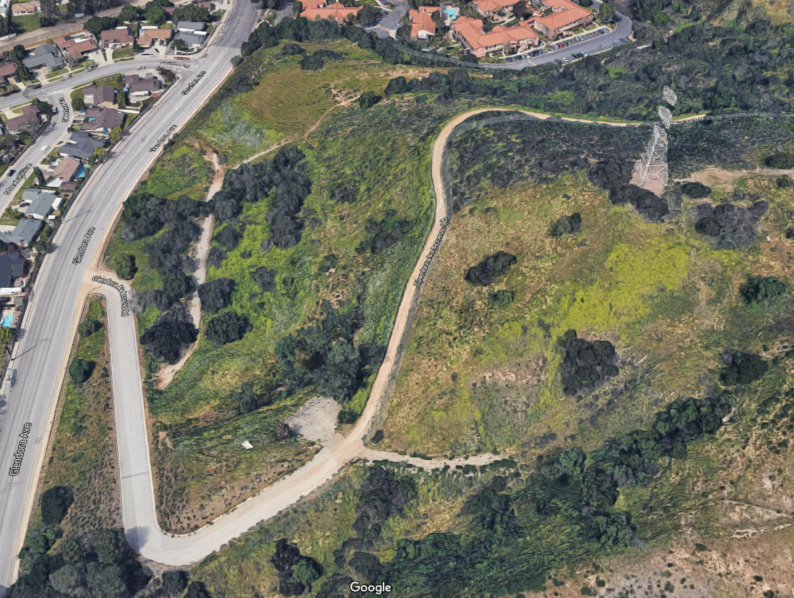
HOMELESS ENCAMPMENTS
Notes:
Andrea Ampig

Slide 49
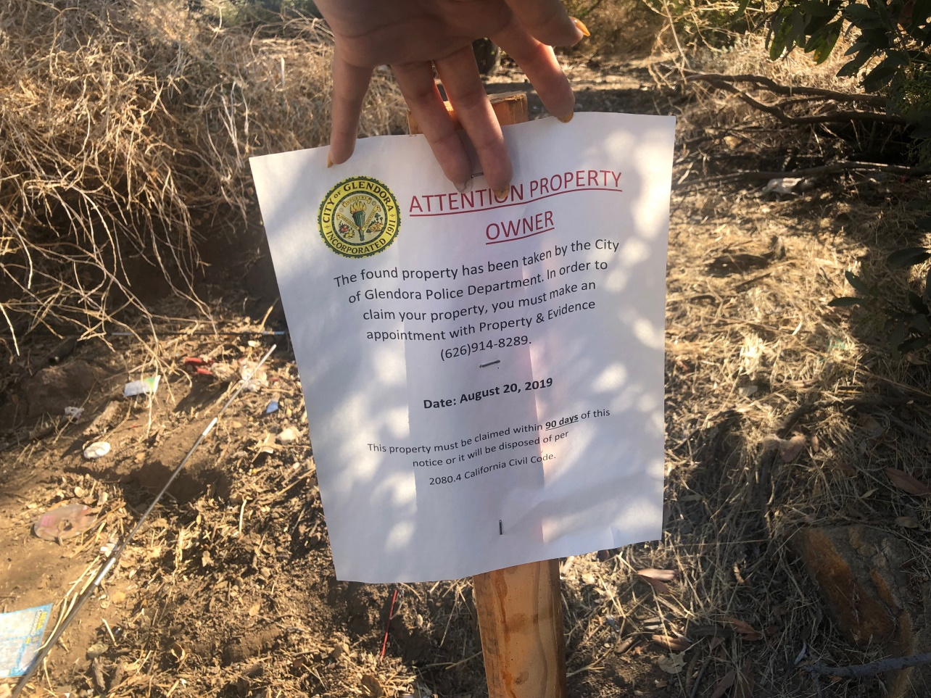
HOMELESS ENCAMPMENTS
Notes:
Andrea Ampig

Slide 50
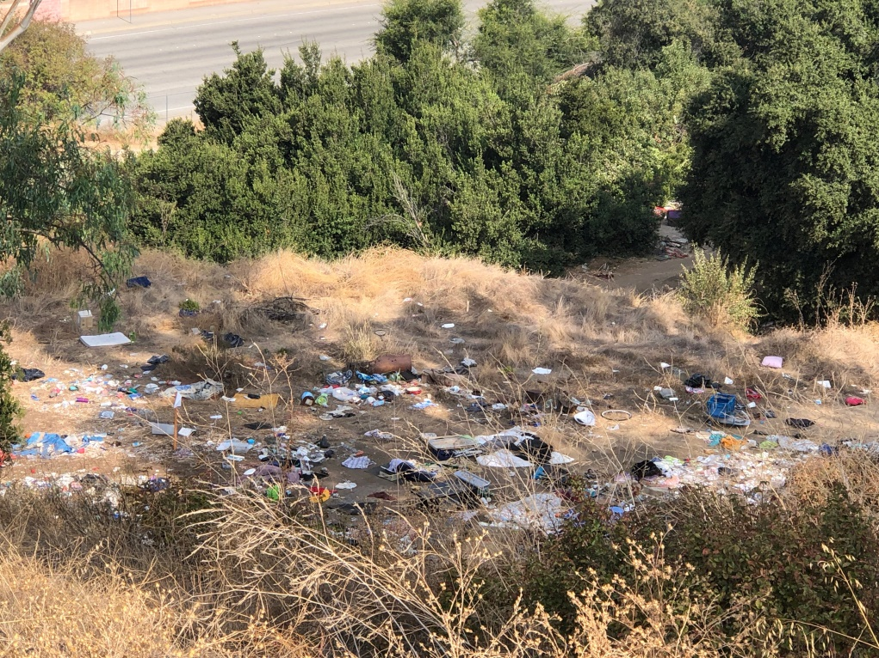
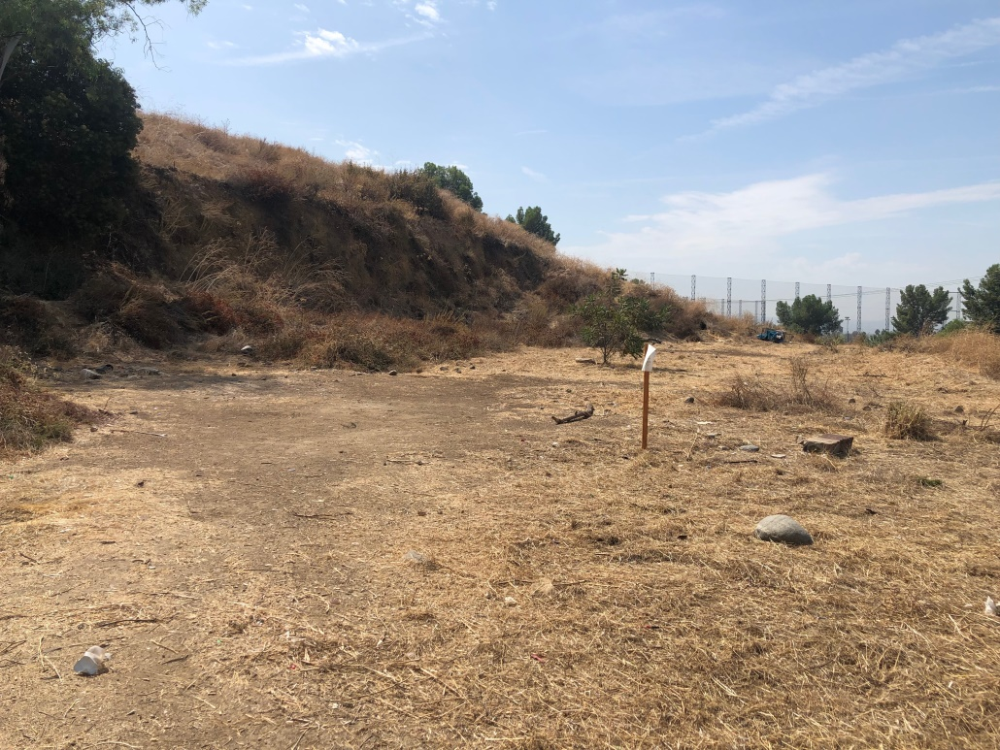
HOMELESS ENCAMPMENTS
Notes:
Andrea Ampig

Slide 51
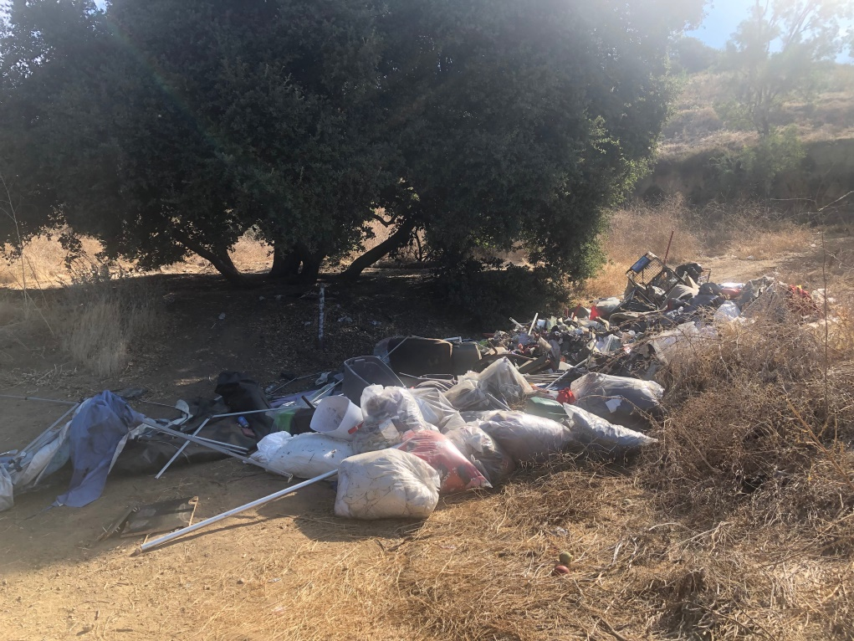
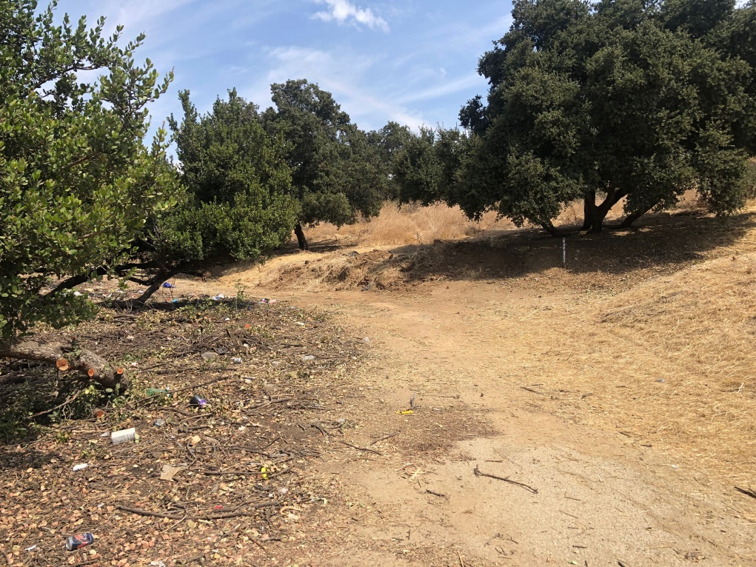
HOMELESS ENCAMPMENTS
Notes:
Andrea Ampig

Slide 52
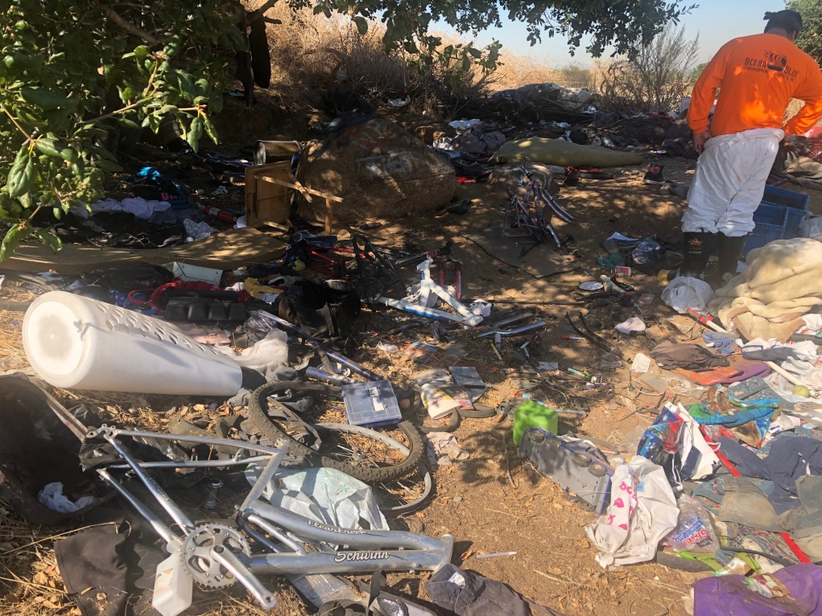
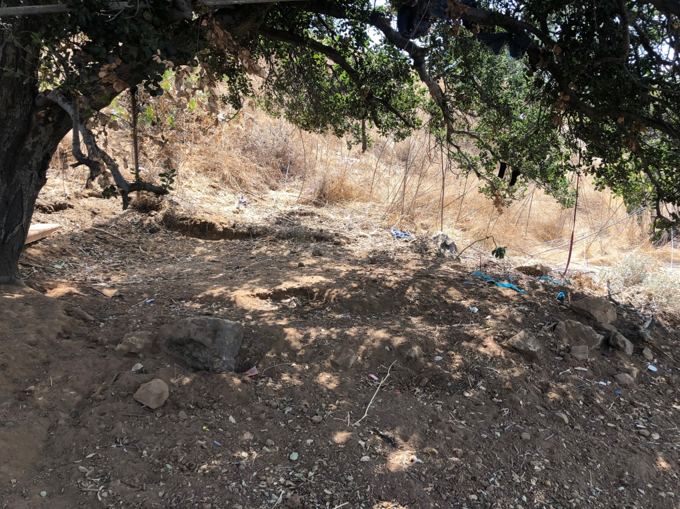
HOMELESS ENCAMPMENTS
Notes:
Andrea Ampig

Slide 53
HOUSING
Notes:
WELCOME
Mayor
General Greeting
City Manager
Expectation Setting
Acknowledge Frustration
Took Decades to Get Here – Solutions to Not Happen Overnight
This will take an entire community

Slide 54
Inclusive Housing Regulations
Emergency Shelters
Transitional Housing
Supportive Housing
Single-room Occupancy (SRO)
Licensed Care Facilities
Accessory Dwelling Units
Notes:
Jeff Kugel

Slide 55
Emergency Shelters
Housing with minimal support services for homeless persons.
Occupancy of six months or less.
Total number of beds for entire City = 20
Notes:
Jeff Kugel

Slide 56
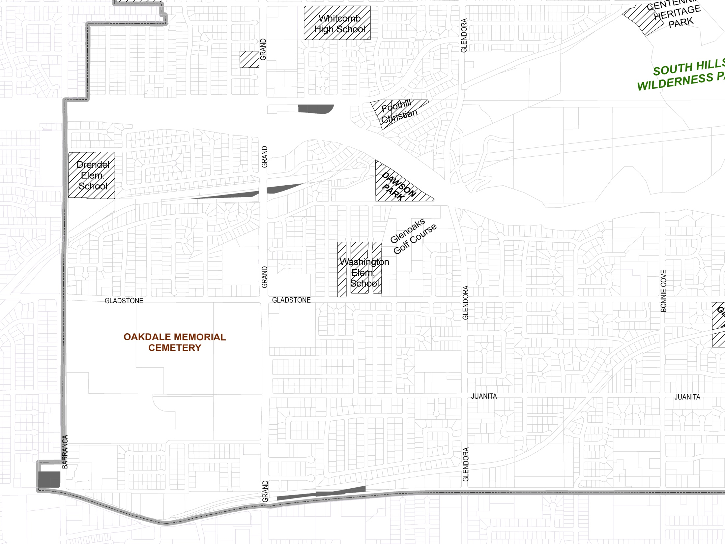
Emergency Shelters
Notes:
Jeff Kugel

Slide 57
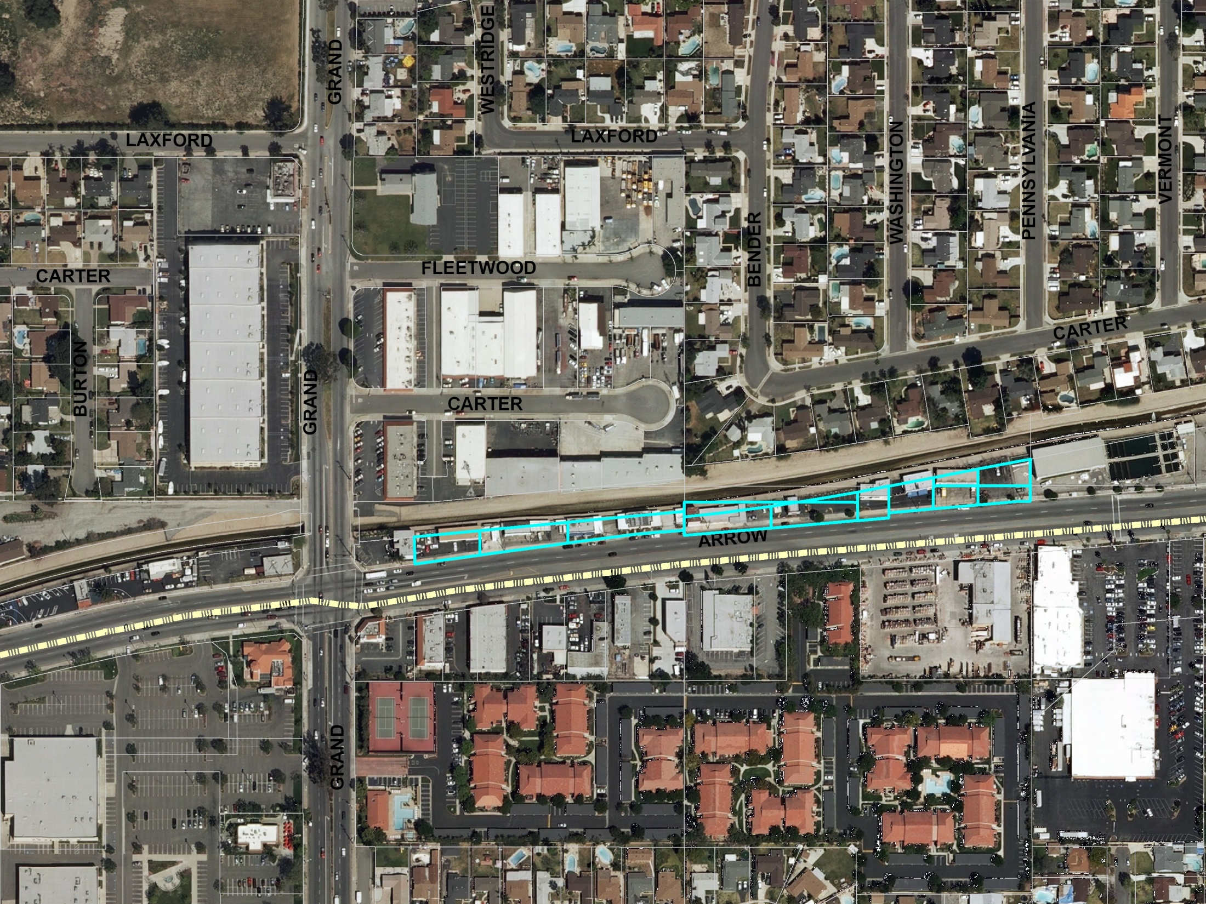
Notes:
Jeff Kugel

Slide 58
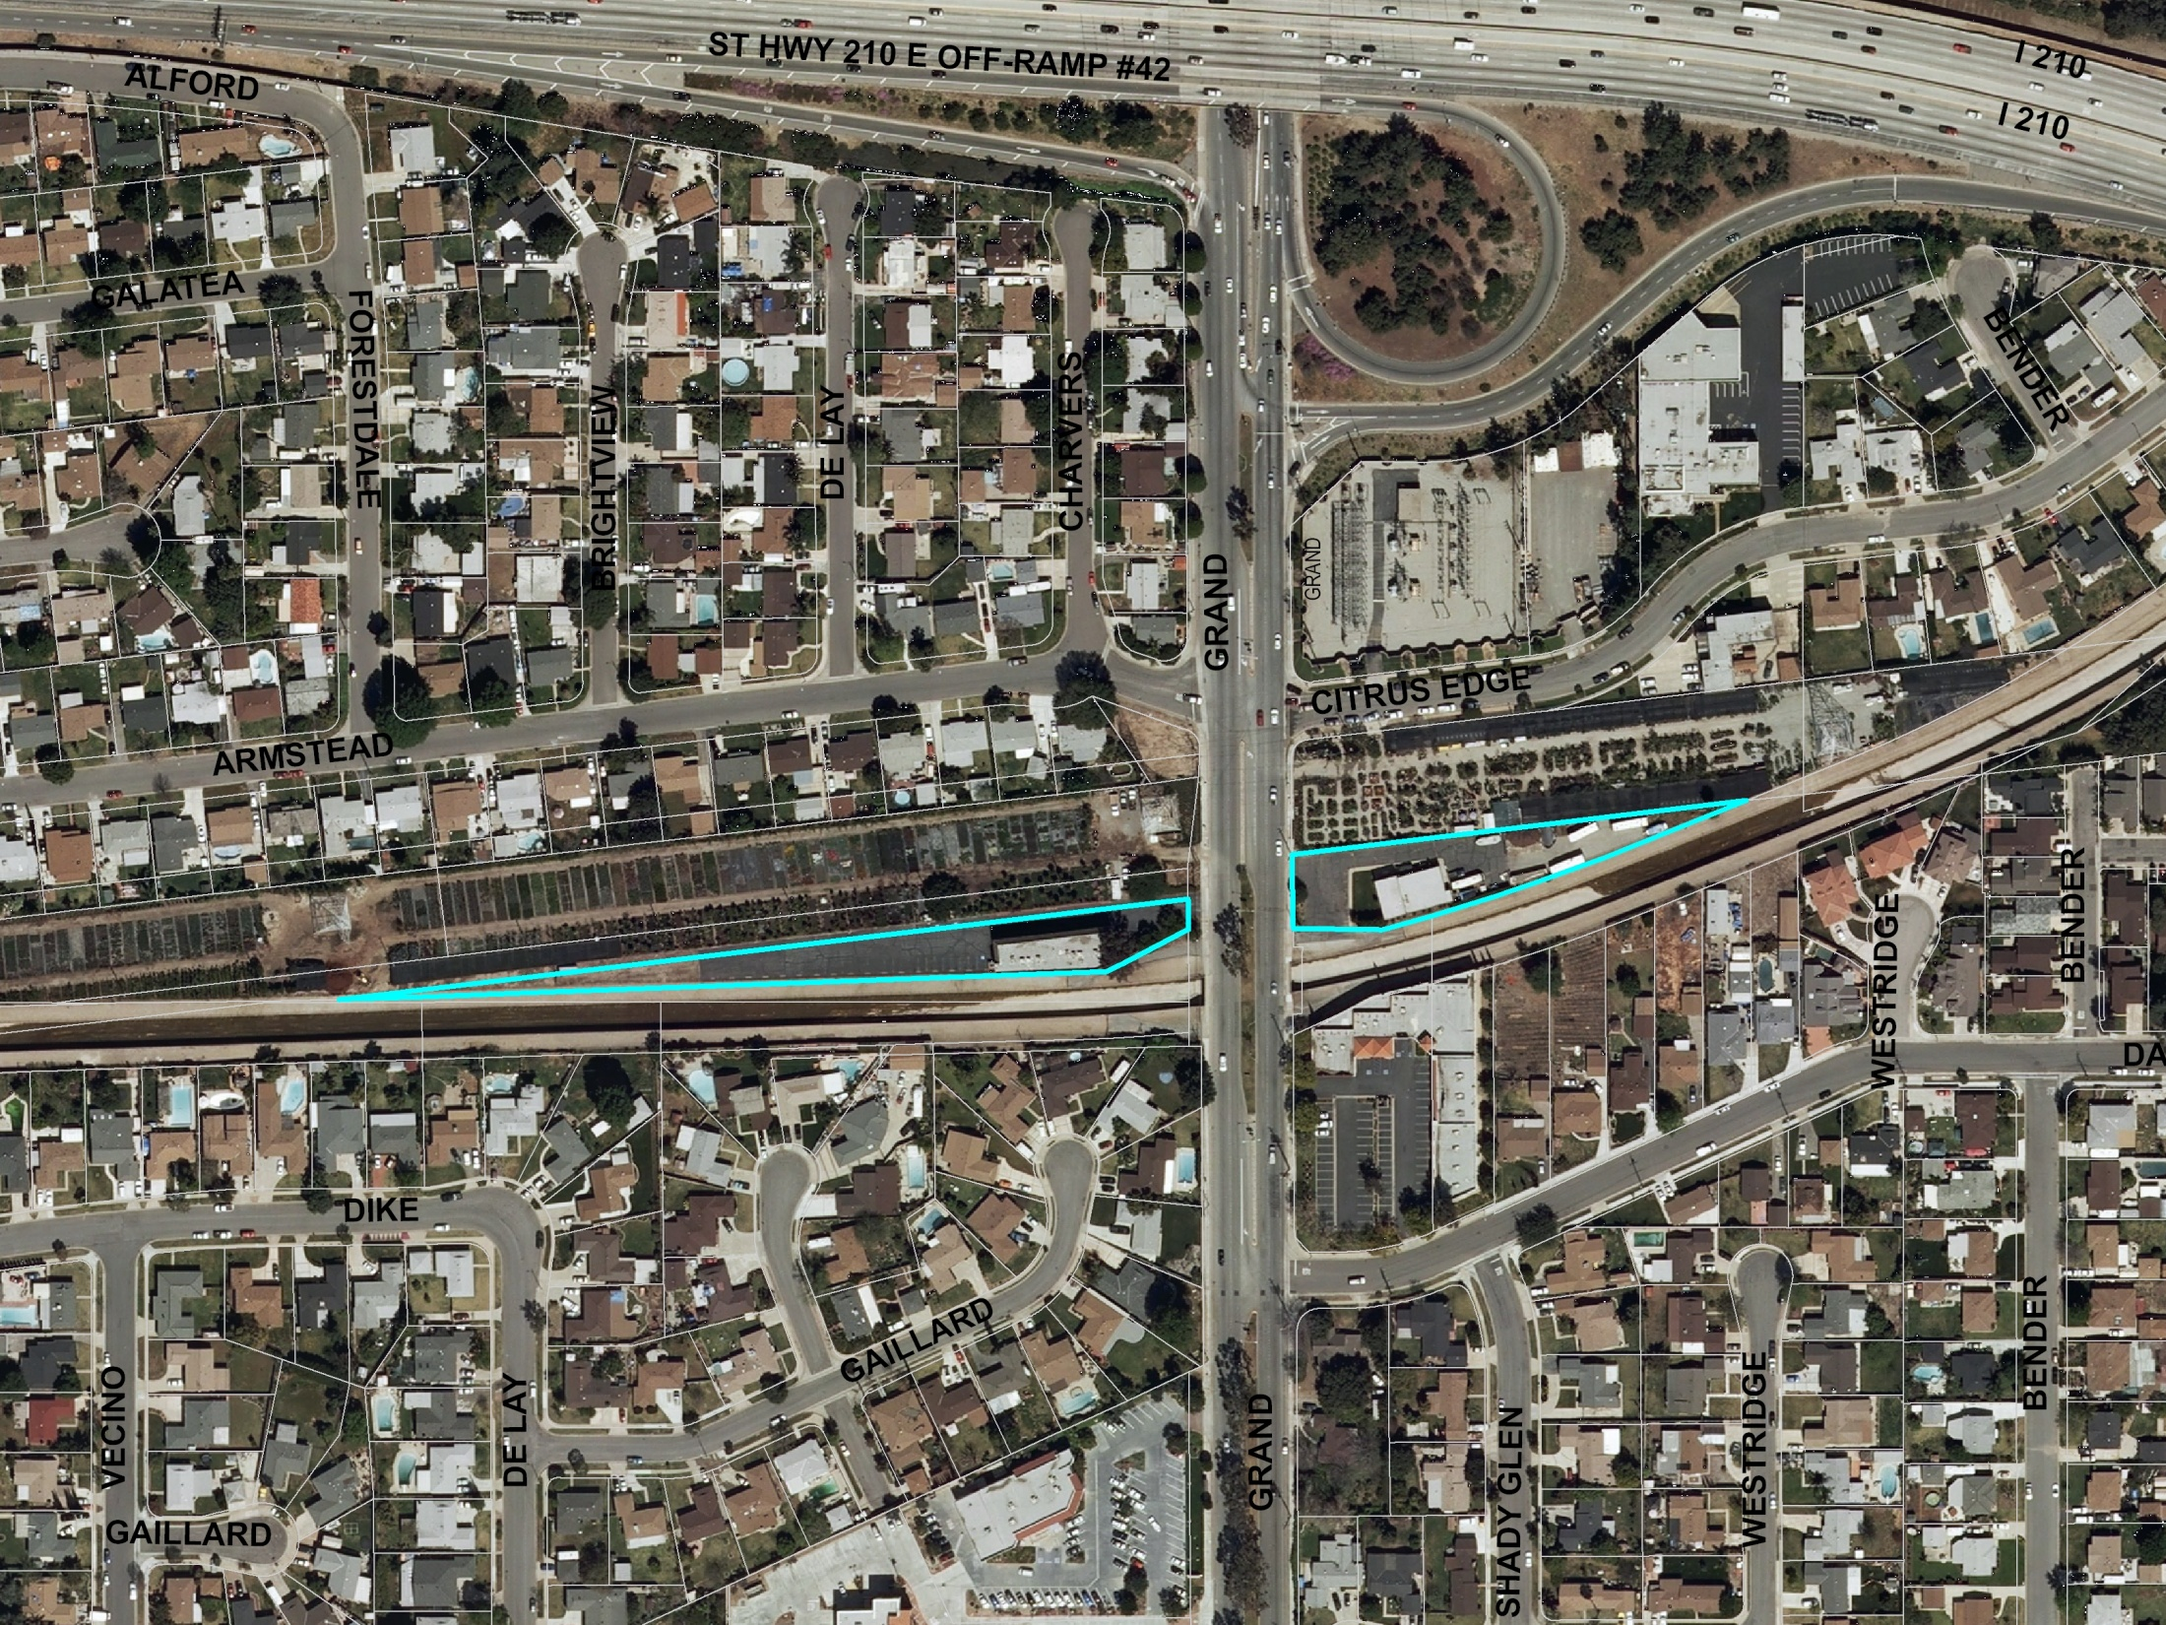
Notes:
Jeff Kugel

Slide 59
Transitional Housing
Housing Used to facilitate the movement of homeless individuals and families to permanent housing
Occupancy up to two years.
Permitted in multi-family residential zones
Notes:
Jeff Kugel

Slide 60
Supportive Housing
Permanent rental housing linked to supportive services designed to enable former homeless to maintain stable housing
Permitted in multi-family residential zones
Notes:
Jeff Kugel

Slide 61
“SRO” Housing – Single Room Occupancy
One-room units intended for an individual.
May have shared bathroom or kitchen facilities.
May serve former homeless (supportive housing).
Subject to same requirements as other residential development.
Permitted in Route 66 – CRR subdistrict
Notes:
Jeff Kugel

Slide 62
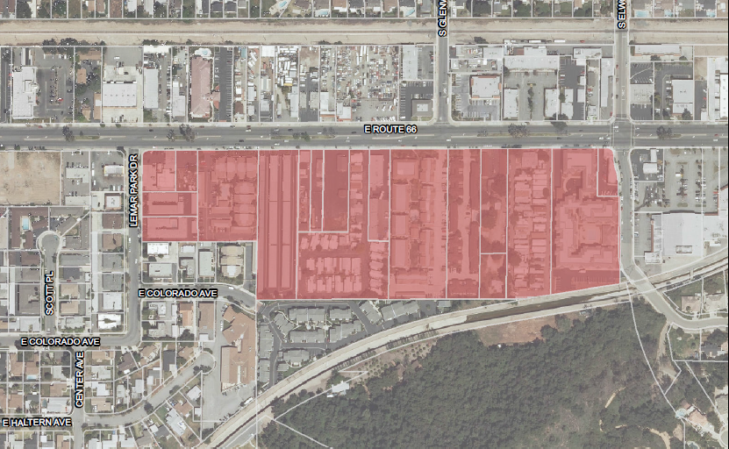
Route 66 - CRR
Notes:
Jeff Kugel

Slide 63
MEASURE H FUNDING
    Measure H Funding for Housing
      Regional Placement vs. City Placement
Notes:
Adam Raymond

Slide 64
HOMELESS RESOURCES
Notes:
Adam Raymond

Slide 65
HOMELESS RESOUCES
City Guide
  List of available resources by type and by target population
Notes:
Debbie Lopez

Slide 66
HOMELESS RESOUCES
Shepherd’s Pantry
  Craig Cerro
Los Angeles Homeless Services Authority (LAHSA)
  Elizabeth Heger, Sabrina De Santiago, Daniella Alcedo
Union Station Homeless Services
  Maria Lopez, Debbie Mota, Shawn Morrissey
LA County Homeless Initiative
  Leticia Colchado
Notes:
Debbie Lopez
We have several partners here tonight and I would like to bring them up.
Craig -

Slide 67
STAFF INVOLVEMENT
Notes:
Adam Raymond

Slide 68
CITY STAFF INVOLVEMENT
Community Services
  SGVCOG
  Measure H Grants
  Community Partners
  Community Centers
Notes:
Debbie Lopez
The Community Services Department is the lead for Homelessness in Glendora
I am the Homeless Liaison for the San Gabriel Valley Council of Governments and Councilmember Karen Davis is on their Board. I am the Liaison for the Measure H grants which I have been working very hard to get them up and running. Remember these are for 18 months grants and then we will start over again for new ones. Measure H funds are for 10 years. We have many community partners as well as different cities that have worked together in collaboration. In our community centers we are trying to get staff trained and feel comfortable working with the homeless.
This has been an overwhelming task as we do not have additional staff and it has been very challenging. Currently cities have to provide homeless services at an extraordinary high level that was not required before in addition to getting their regular duties completed.
Some of the challenges have been not enough staff, learning to work with many community partners as well as the County, LAHSA and many other organizations. One of the challenges for me personally has been to accept homeless people as they are and see them as human beings and not drug addicts or mentally ill people.
I would like Carol Stellato to speak on experience with the homeless.

Slide 69
CITY STAFF INVOLVEMENT
Community Services
  Challenges
    Staffing levels
    Funding with strings attached
    Changing requirements
  Opportunities
    Establish lasting partnerships
    Better quality of life for all residents
Notes:
Debbie Lopez
Carol Stellato
The Community Services Department is the lead for Homelessness in Glendora
I am the Homeless Liaison for the San Gabriel Valley Council of Governments and Councilmember Karen Davis is on their Board. I am the Liaison for the Measure H grants which I have been working very hard to get them up and running. Remember these are for 18 months grants and then we will start over again for new ones. Measure H funds are for 10 years. We have many community partners as well as different cities that have worked together in collaboration. In our community centers we are trying to get staff trained and feel comfortable working with the homeless.
This has been an overwhelming task as we do not have additional staff and it has been very challenging. Currently cities have to provide homeless services at an extraordinary high level that was not required before in addition to getting their regular duties completed.
Some of the challenges have been not enough staff, learning to work with many community partners as well as the County, LAHSA and many other organizations. One of the challenges for me personally has been to accept homeless people as they are and see them as human beings and not drug addicts or mentally ill people.
I would like Carol Stellato to speak on experience with the homeless.

Slide 70
CITY STAFF INVOLVEMENT
Police
  Intro and Overview of PD Content – L. Rosales, Police Chief
  Day to Day Operations – M. Egan, Police Captain
  Community Impact Team – R. Lombardi, Police Detective
  Closing Comments – L. Rosales, Police Chief
Notes:
Lisa Rosales

Slide 71
CITY STAFF INVOLVEMENT
Police
  Day to Day Operations – M. Egan, Police Captain
    Encampment procedures
    Clean-up vs. enforcement
  Programs
    HALO
    HOST
  Challenges
    Balance call activity with added homeless call activity
    Calls for service
Notes:
Matt Egan

Slide 72
CITY STAFF INVOLVEMENT
Police
  Community Impact Team – R. Lombardi, Police Detective
    Roles and responsibilities
  Trespassing
  Challenges
Notes:
Ryan Lombardi

Slide 73
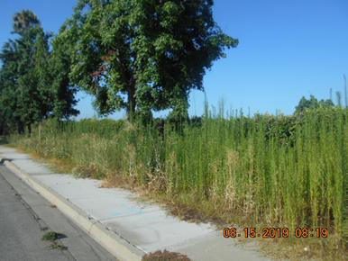
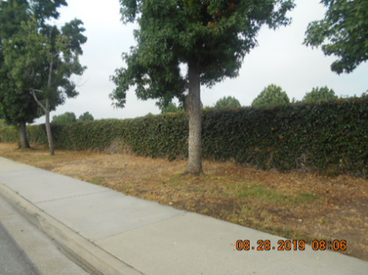
CITY STAFF INVOLVEMENT
Police
  Closing Comments – L. Rosales, Police Chief
    Challenges
      Limited allowable remedies
      Community care
      Fiscal/staffing
    Opportunities
      Education: e.g. website
      Community Policing
Notes:
Lisa Rosales

Slide 74
CITY STAFF INVOLVEMENT
Library – Janet Stone, Library Director
  Free access to the world of ideas
    Equitable, unabridged, welcoming
    Standards based on safety and preventing impedance
Notes:
Janet Stone

Slide 75
CITY STAFF INVOLVEMENT
Library
  Facility
    Shelter, power, restrooms, water, climate control, information access, intentional philosophy of dignity
    Sanitation
    Physical accessibility
    Security
    Behavioral expectations
Notes:
Janet Stone

Slide 76
CITY STAFF INVOLVEMENT
Library
  Staff interactions
    Rapidly evolving population
    Different dependence on resources
    Heightened consequence of unmet needs
    Hazards, impedance, and aesthetics
    Direct impact; customer impact
Notes:
Janet Stone

Slide 77
CITY STAFF INVOLVEMENT
Library
  Challenges
    Balance, change, visibility
    Building architecture and sanitation
    Access to critical areas
    Clarity of general security environment
    Environmental design & impact
      Electricity, seating, lighting, etc.
Notes:
Janet Stone

Slide 78
CITY STAFF INVOLVEMENT
Library
  Challenges
    Unfamiliarity
    Aesthetics
    Categorization
Notes:
Janet Stone

Slide 79
CITY STAFF INVOLVEMENT
Library
  Opportunities
    Day space
    Self-help resource center
    Trained-staff referral or resource center
    Long-time traditions
      Equity, confidentiality, trust
    Connection
Notes:
Janet Stone

Slide 80
CITY STAFF INVOLVEMENT
City Manager’s Office
  Daily operations
    Increasing e-mails
    Increased calls
    More daily interactions
    Constant communication with partners
    Research on solutions
Notes:
Adam Raymond

Slide 81
CITY STAFF INVOLVEMENT
City Manager’s Office
  Challenges
    Social media
    Emotional topic
    Changing guidelines
    Fiscal impacts
  Opportunities
    Education
    Engaged Community
Notes:
Adam Raymond

Slide 82
COMMUNITY INVOLVEMENT
Notes:
Adam Raymond

Slide 83
CITY STAFF INVOLVEMENT
How can you get involved?
  Volunteer
  Donate
  Make your voice heard
    Homelessness@CityofGlendora.org
    (626) 852-5200
Notes:
Adam Raymond

Slide 84
COMMUNITY INVOLVEMENT
Who/when should I call for questions/concerns?
  Community Services Department
    General homelessness questions
    Services for homeless individuals
    Get Involved
    Homelessness@CityofGlendora.org
    (626) 852-5200
Notes:
Adam Raymond

Slide 85
COMMUNITY INVOLVEMENT
Who/when should I call for questions/concerns?
  Police Department
    Emergencies
      Call 9-1-1
    Trespassing
      (626) 914-8250
Notes:
Adam Raymond

Slide 86
COMMUNITY INVOLVEMENT
Who/when should I call for questions/concerns?
  Park and Ride
    Public Safety and Enforcement Issues
      Highway Patrol
        (626) 338-1164
        (323) 259-3200
    Maintenance Issues
      CalTrans
        (213) 897-3656
Notes:
Adam Raymond

Slide 87
COMMUNITY INVOLVEMENT
Who/when should I call for questions/concerns?
  Railroad
    Public Safety and Enforcement Issues
      LA County Sheriff Transportation Bureau
        (323) 563-5000
    Maintenance Issues
      Metro
        (888) 446-9721
      Gold Line Construction Authority
        (626) 471-9050
Notes:
Adam Raymond

Slide 88
COMMUNITY INVOLVEMENT
  Animals
    Inland Valley Human Society
      https://www.ivhsspca.org/
      (909) 623-9777 (regular business hours)
      (909) 594-9858 (after hours emergency)
Notes:
Adam Raymond

Slide 89
NEXT STEPS
Notes:
Adam Raymond

Slide 90
NEXT STEPS/MOVING FORWARD
Assess feedback
Communicate with Community
Target solutions
Funding options and service impacts
Prioritize objectives (examples)
  High Fire Hazard Zone Review
  Shopping Cart Ordinance
  Anti-Camping-9th Circuit Complaint Ordinance
  Evaluate Housing Options
  Environmental design strategies
  City staffing levels
  Health and safety concerns
  Better understanding of homeless Population
Notes:
Adam Raymond

Slide 91
NEXT STEPS/MOVING FORWARD
Community partnerships
Educated decisions
No singular solution
For more information/questions please visit
www.CityofGlendora.org/homelessnessplan
Contact Staff:
Homelessness@CityofGlendora.org
Notes:
Adam Raymond

Slide 92
THANK YOU
Glendora City Council Members can be reached at City_Council@cityofglendora.org
Notes:
Adam Raymond

